Slide 1
Information for Centers

Slide 2
Agenda
Importance of Kangaroo Care and Holding
Holding During Therapeutic Hypothermia
Hold-A-Thon Overview
Resources

Slide 3
Kangaroo Care & Holding

Slide 4
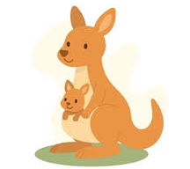
Kangaroo Care
Simulates a kangaroo’s pouch
Method of holding a baby skin-to-skin, upright against a parent's bare chest, typically dressed only in a diaper and hat
Typically focused on preterm population
Activates oxytocin that leads to parental and infant benefits

Slide 5
Benefits of Kangaroo Care
Infant
Parent
Mortality reduction
Infection prevention
Enhanced physiological vital sign stability
Improved breastfeeding and growth
Improved somatosensory stimulation
Improved newborn sleep organization
Reduced crying and pain scores
Improved attachment quality and socio-emotional development later in infancy
Improved mood
Reduced depressive symptoms
Enhanced stress regulation
Enhanced bonding and attachment
More sensitive caregiving responses

Slide 6
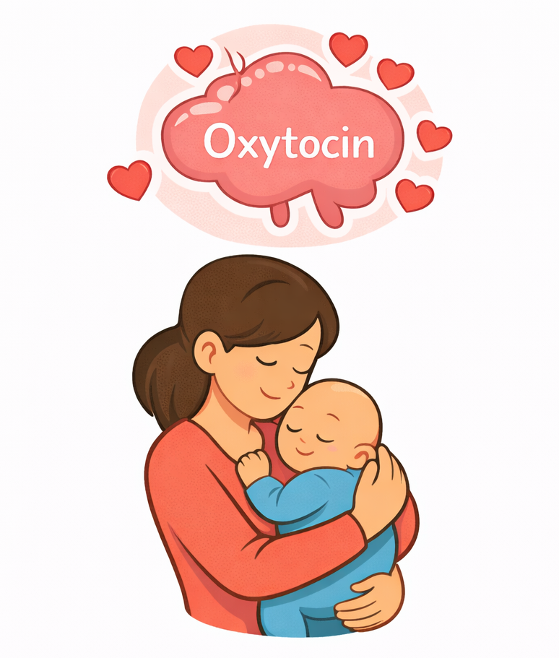
Holding
Somatosensory stimulation
Opportunities for face-to-face interaction
Supporting newborn sleep organization
Enhanced temperature and heart rate regulation
Reduced crying
Improved attachment quality
Enhanced socio-emotional
development later in infancy
Parent holding without direct skin-to-skin contact
Important and parallel benefits to kangaroo care, though effects may be less pronounced

Slide 7
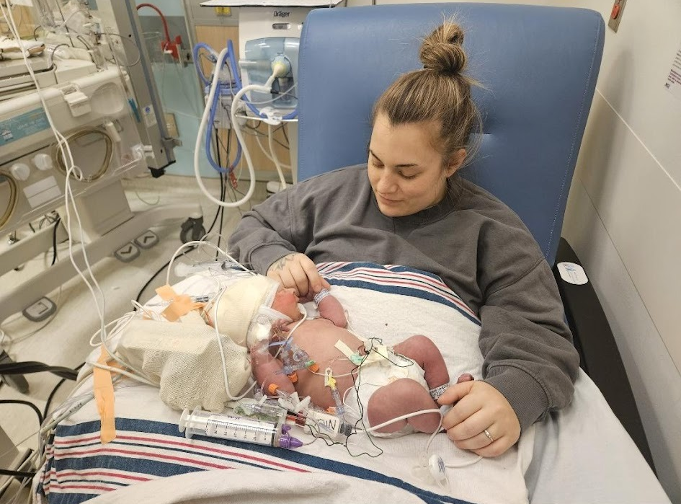
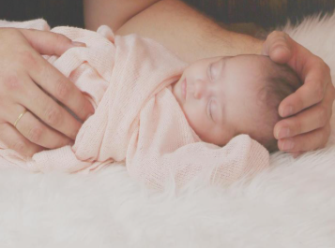
Holding During Therapeutic Hypothermia Is Possible
Confirm infant is stable enough to hold (as per unit protocol)
Seat parent close to the infant with a pillow on their lap
Secure lines and transfer infant in the cooling blanket (two staff members)
Rest the infant on the pillow in the parent’s arms
Oral care may also be considered while holding
Hand Hugs Are Option if Holding Contraindicated
Gently place one hand on infant’s head
Place the other hand across their tummy or cupping their feet
Moderate firm pressure and still touch are best
Avoid stroking or patting, as this can be overstimulating

Slide 8
Holding During Therapeutic Hypothermia

Slide 9
Holding During Therapeutic Hypothermia
Direct skin-to-skin care during therapeutic hypothermia risks that temperature will increase outside of the therapeutic zone
Therefore direct skin-to-skin care is not recommended
However, holding is still very important!

Slide 10
Safety
Carefully supervised holding can be performed without
Clinically significant rewarming
Temperature instability
Adverse events such as central line or endotracheal tube dislodgement
Standardized protocols are important

Slide 11
Barriers & Solutions
Institution
Lack of nationally endorsed guidelines > develop local protocols & collect data
Physical space constraints > adapt equipment/spaces
Clinician
Perception of risk/benefit > education on published data & trauma informed care
Staffing requirements > flexible staffing protocols & minimum staff requirements
Absence of protocols for safe transfer > hands on practice
Parent
Stress, trauma & fear > trauma-informed care, peer support services, & education
Competing obligations > engagement of SW & other support services

Slide 12
Allows parents to hold during hypothermia while employing the 6 principles of trauma informed care to help them recover from the birth trauma and trauma associated with hypothermia treatment

Slide 13
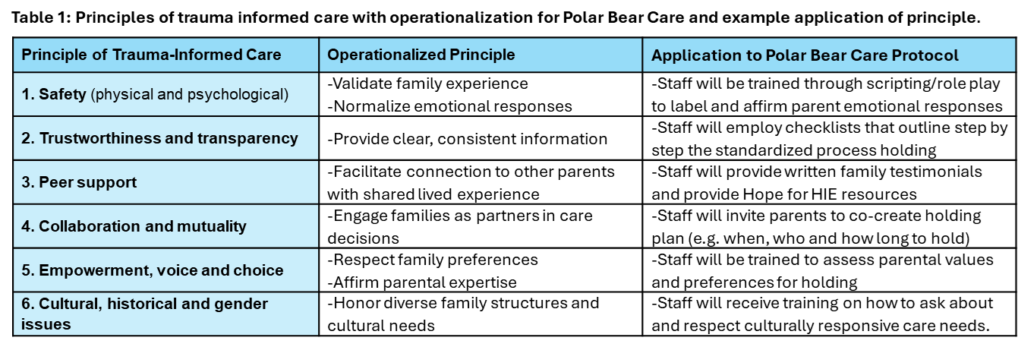
Trauma-Informed

Slide 14
Hold-A-Thon Overview

Slide 15
VISION
MISSION
A future in which care for newborns treated with therapeutic hypothermia includes safe, trauma-informed opportunities for holding that support newborns and their families and that foster bonding.
To advocate and educate about safe and trauma-informed, family-centered practices for holding newborns during treatment with therapeutic hypothermia.

Slide 16


What is a hold-a-thon?
A fun event designed to promote and normalize holding & other forms of positive touch for babies by providing standardized clinical support, staff engagement, and cultural reinforcement of family-centered care
Expand from preterm infants to include infants with HIE

Slide 17
Why have a hold-a-thon?
38%
Only 38% of NICUs offer holding during therapeutic hypothermia

Slide 18

When is the hold-a-thon?
APRIL 2026
A month-long initiative to ensure all units have a chance to participate - in honor of HIE awareness month

Slide 19
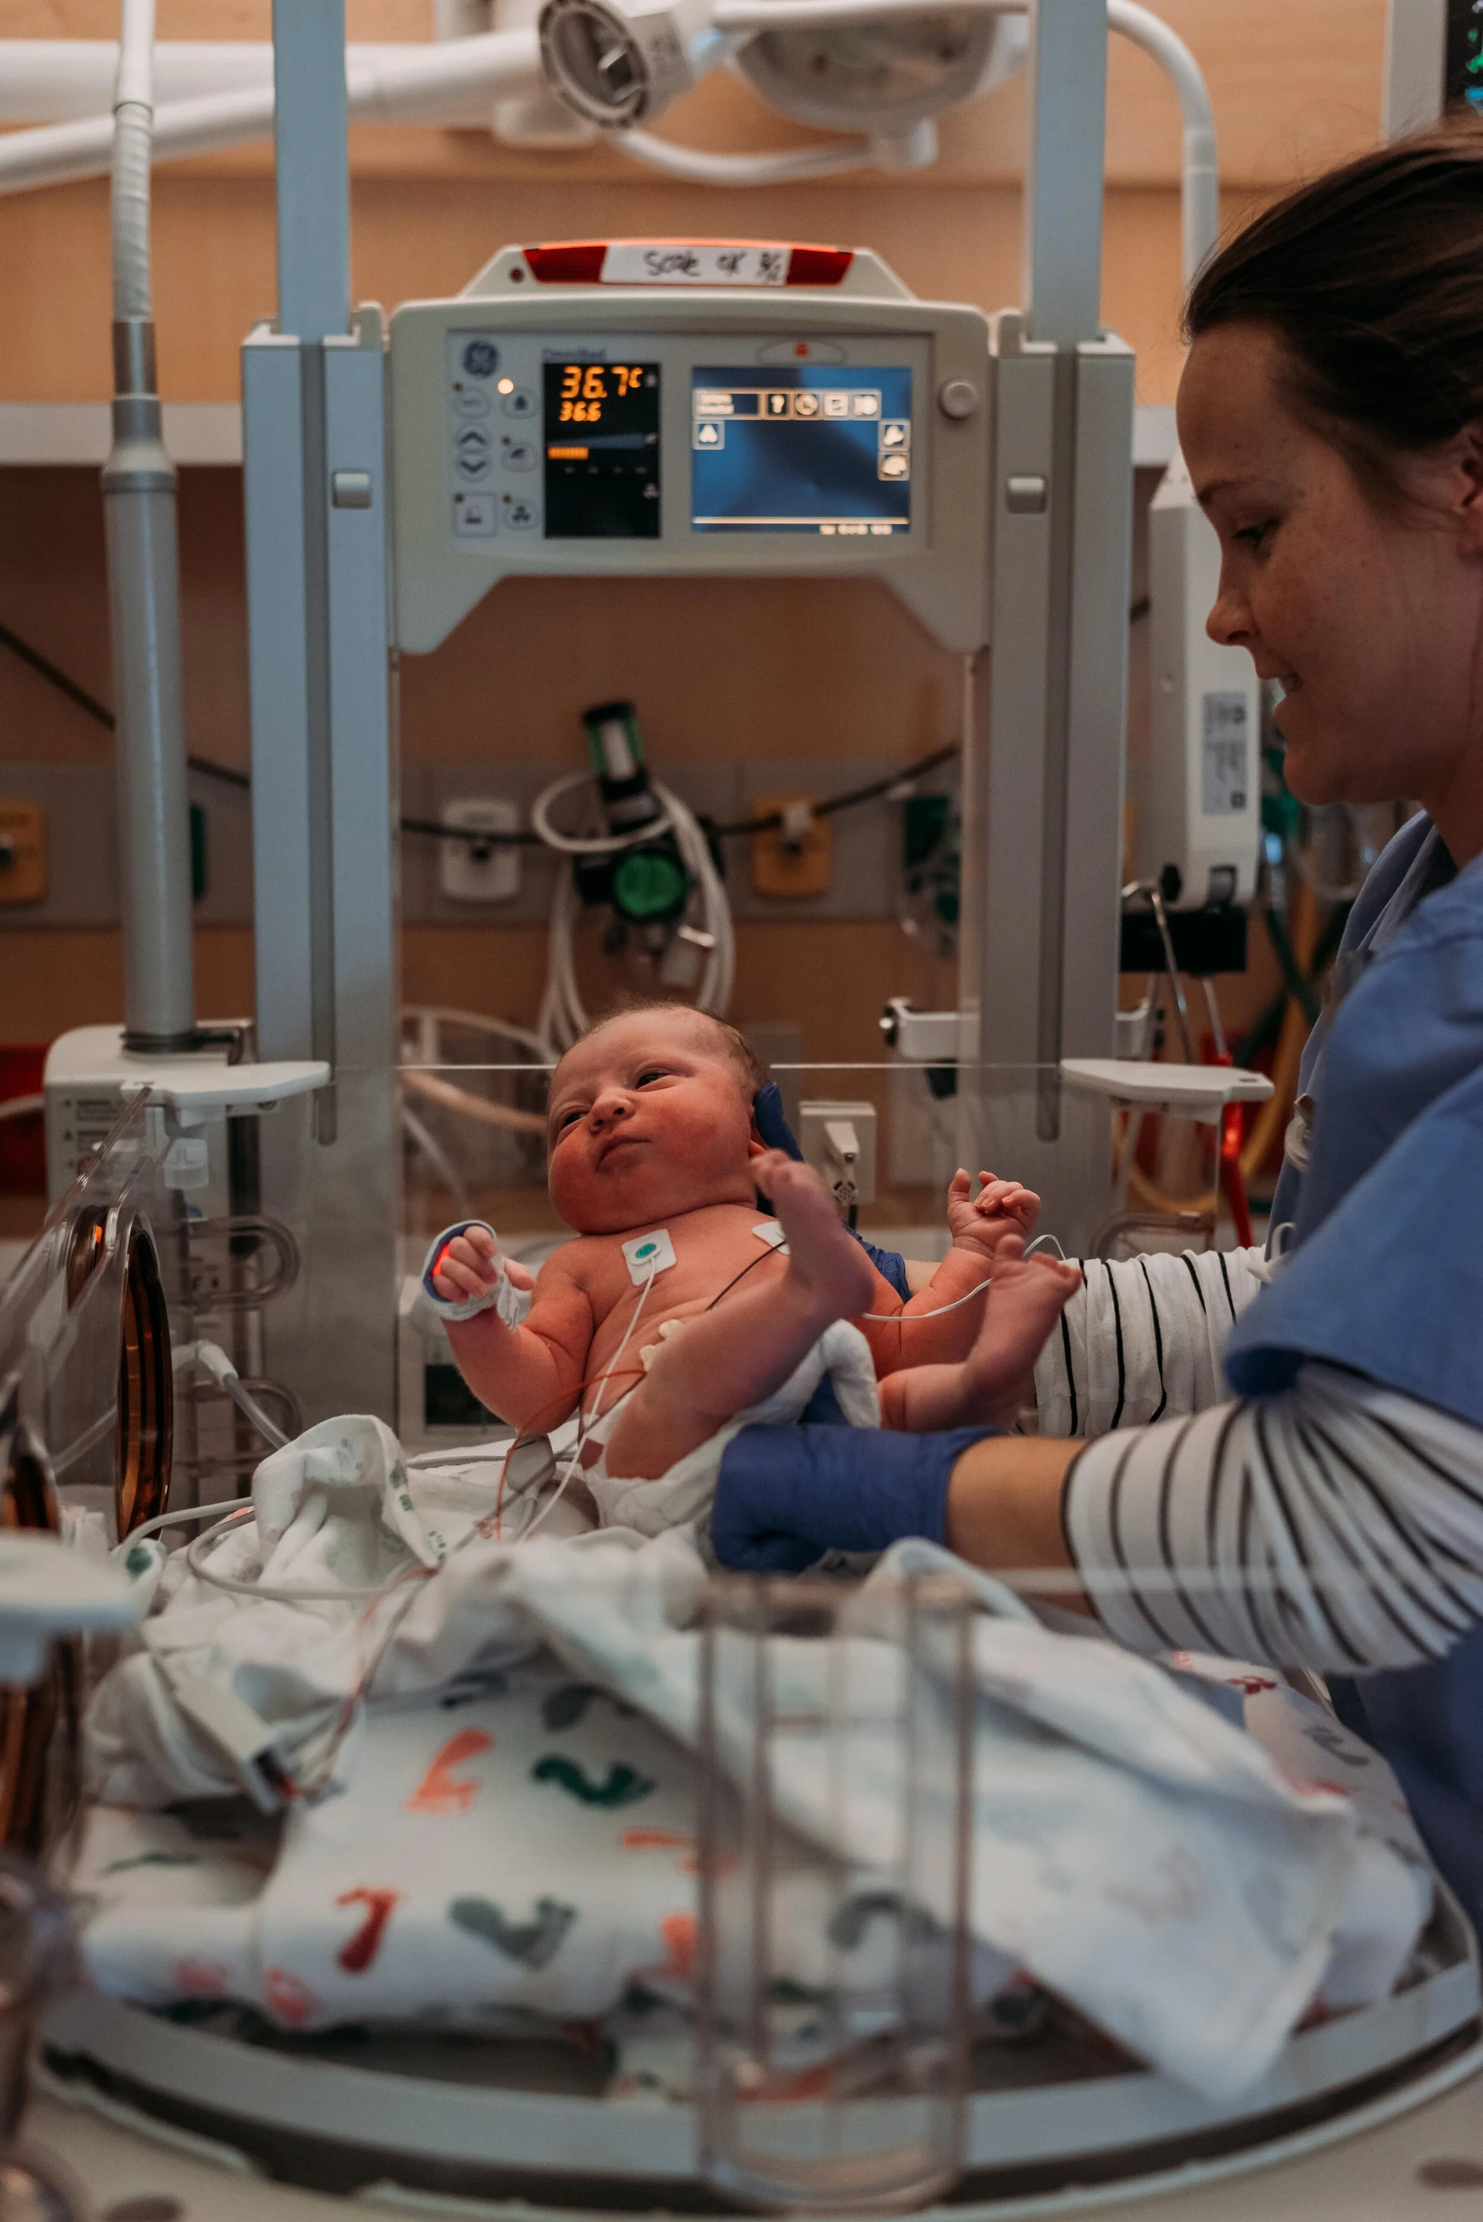

Where is the hold-a-thon?
In your NICU

Slide 20
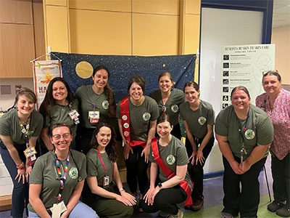
Who participates in the hold-a-thon?
A hold-a-thon is a great way to get parents, nurses, doctors and administrators all focused on a joint goal of improving family centered care

Slide 21
Timeline
Jan. 2026
Site recruitment, sponsor endorsement, toolkit completion
Feb. 2026
Institutional protocol development
Mar. 2026
Staff education and training
Apr. 2026
HIE Awareness Month and Hold-a-thon event and advocacy campaign
May 2026
Impact evaluation and reporting

Slide 22
Resources

Slide 23

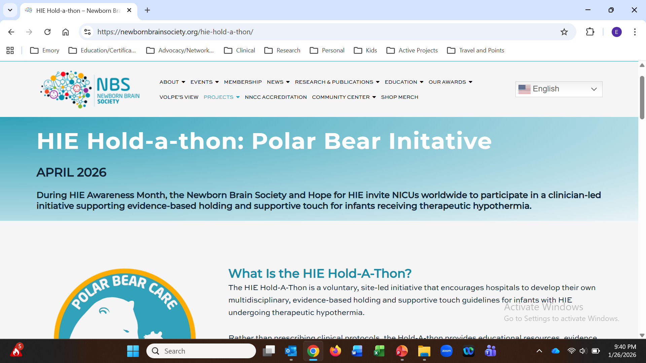
Website
https://newbornbrainsociety.org/hie-hold-a-thon or http://polarbearcare.org/

Slide 24

Monthly Meetings with Organizers & Other Centers

Slide 25
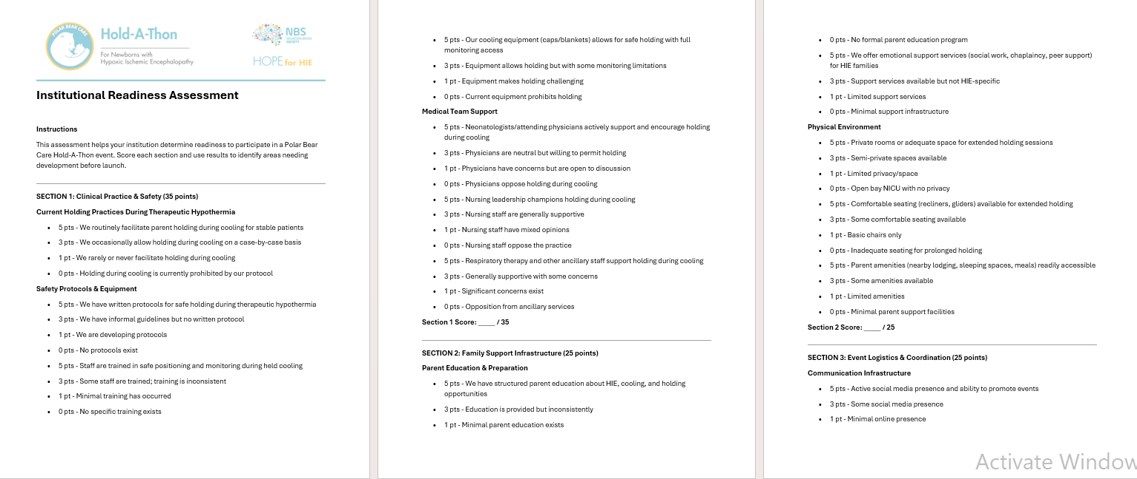
Institutional Readiness Assessment

Slide 26
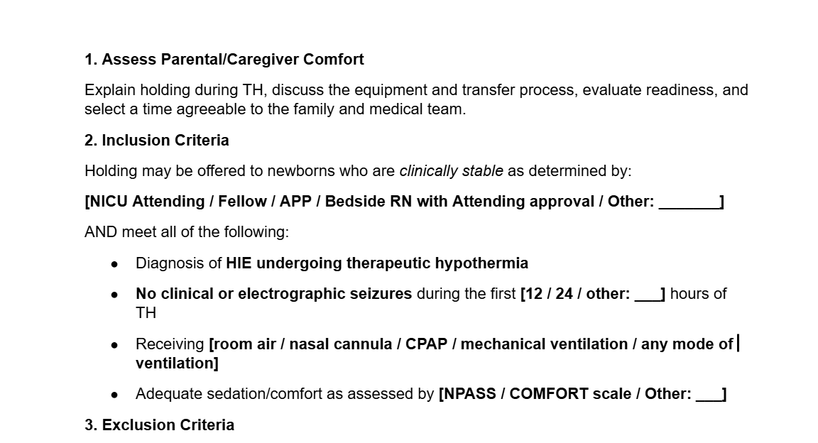
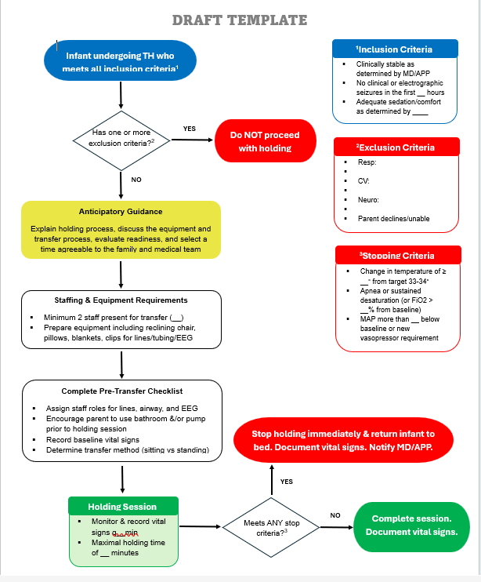
Guideline Development

Slide 27
Site Engagement & Swag
Bingo
Fact or Fiction Quiz
Email templates
Parent flyers/brochures
Nursing script based on trauma-informed care principles

Slide 28

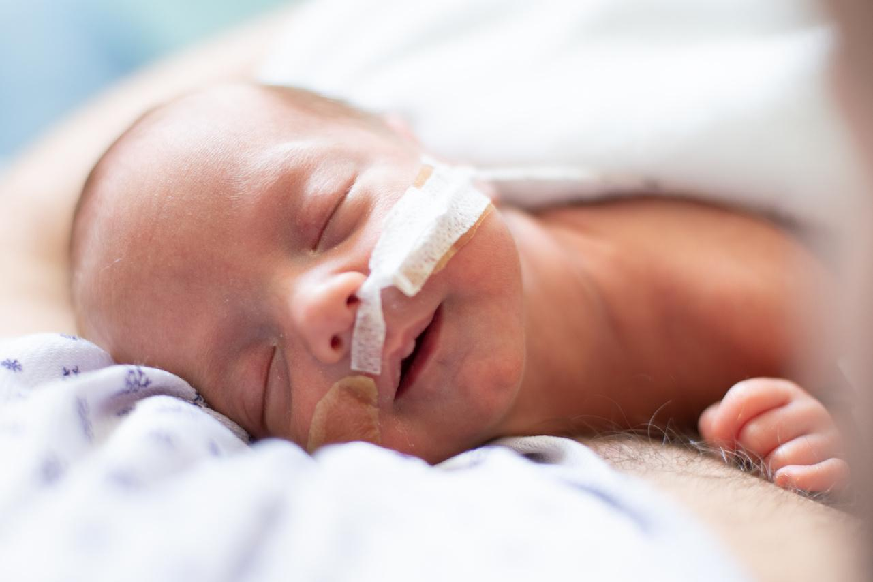
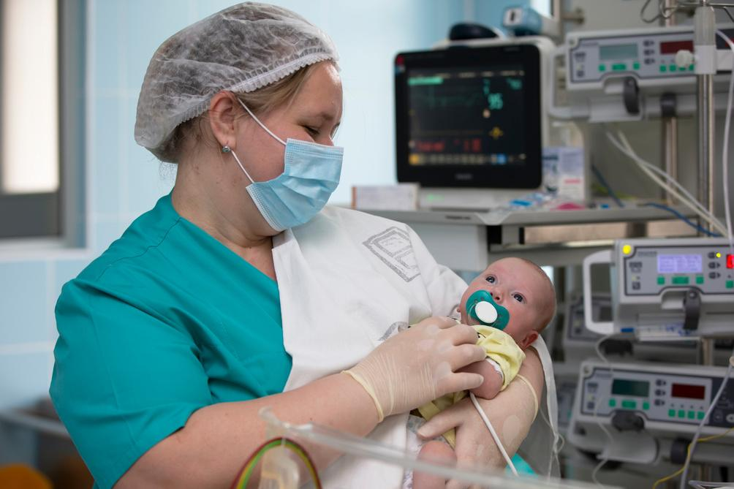


Join the Newborn Brain Society
A world in which all newborns have access to and receive the optimal brain care.
To advance newborn brain care through international multidisciplinary collaboration, education, and innovation.
VISION
MISSION
Over 1400 members
Affiliations
OUR
MEMBERS
Representing 80 countries
Physicians, Neonatology
Advanced Practice Nurses
Physicians, Neurology
Nurses
Working in over 500 hospitals, institutions, and clinics
Physicians, Other
Basic Science Faculty Members
Allied Health Professionals
Trainees & Students
Community Members
General Non-Physician
Become a Member!
General
Physician
General
LMIC
Junior
Member
$175 annual dues
$130 annual dues
$25 annual dues
Free
Physicians who are health care provider or member of the community interested in Neonatal Neurology.
Non-physicians who are health care provider or member of the community interested in Neonatal Neurology.
Members in a country with “low-income economy,” “lower-middle-income economy,” or “upper-middle-income economy.”
Members who are in a Training Program (e.g., medical or scientific training program).

Slide 29


